Slide 1
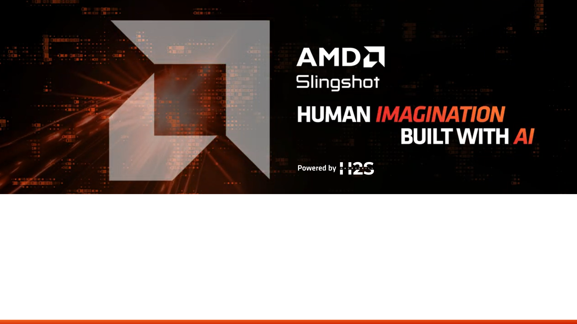
Team Details
Team name - HELLSTER
Team leader name – Ayush Verma
Problem Statement - System that predicts vehicle component failures early to enable preventive maintenance and improve safety.

Slide 2

Brief about the idea
This project presents a Smart Vehicle Health Monitoring System built on a Ryzen-powered edge computing architecture. The system collects real-time data from multiple vehicle subsystems such as engine, battery, braking, and tyres, and processes it locally using AI-based predictive models. By using the multi-core performance and compute capabilities of AMD Ryzen processors, the platform performs sensor fusion, anomaly detection, and predictive maintenance analytics. The output is delivered through an interactive dashboard that provides diagnostics, risk alerts, and estimated safe runtime, enabling proactive maintenance and improved vehicle reliability.
Sensors → Data Interface → Ryzen Edge Computer → AI Models → Dashboard / Alerts

Slide 3
Opportunities
How different is it from any of the other existing ideas?
How will it be able to solve the problem?
USP of the proposed solution
Difference: Traditional onboard diagnostics focus on fault detection, not prediction but
Ryzen-powered edge AI predictive maintenance platform
Combines multiple subsystem insights in one unified dashboard and
Focuses on predictive insights.
Problem Solved: Transforms maintenance from reactive to predictive
USP: Ryzen-powered real-time predictive analytics at the vehicle edge

Slide 4
List of features offered by the solution
Multi-Component Health Monitoring ( Engine, Battery, Brakes, Tyres )
Real-Time Parameter Analysis (Temperature, Vibration, Battery health, Brake wear, Tyre pressure)
Automated Health Status Detection (SAFE, LOW, HIGH )
Predictive Maintenance Insights
An interactive predictive maintenance dashboard that monitors multiple vehicle components, analyzes health parameters, and provides early warnings with maintenance recommendations.

Slide 5
Process flow diagram or Use-case diagram
🟦 Step 1 — User Interaction
Open Dashboard 🖥️
↓
🟦 Step 2 — Component Selection
Select Vehicle Area
↓
🟦 Step 3 — Generate Report 📄
Click “Add Area Report”
↓
🟦 Step 4 — Data Processing
Sensor Data Simulation & Threshold Check 📊
↓
🟦 Step 5 — AI Analysis 🧠
Maintenance Prediction + Health Status
↓
🟦 Step 6 — Report Display 📄
Component Report Shown
↓
🟦 Step 7 — Full Scan
Run Complete Vehicle Scan
↓
🟦 Step 8 — Final Output
Overall Health Score ⭐ + Diagnostic Summary + Export

Slide 6

Architecture diagram of the proposed solution
User / Mechanic ↓ Presentation Layer (Web Dashboard / UI) ↓ Application Layer (Frontend + Backend Logic) ↓ Analytics / AI Module ↓ Database ↓ Notification Service

Slide 7
Technologies to be used in the solution
Frontend / Interface
HTML5
CSS3
JavaScript
Simulation & Logic
JavaScript (for sensor simulation and AI prediction logic)
AI / Prediction (Concept Level)
Machine Learning models (Predictive Maintenance algorithms)
Hardware (Future Scope)
IoT Sensors (Temperature, Vibration, Pressure)
Microcontroller (e.g., Arduino / Raspberry Pi)
Data Handling
Local Storage / Cloud Database (future integration)

Slide 8
Usage of AMD Products/Solutions
Processing & AI Computation
AMD Ryzen processors can run the dashboard, data processing, and predictive maintenance algorithms efficiently due to high multi-core performance.
AI Model Acceleration (Future Scope)
AMD GPUs (Radeon / Instinct) can accelerate machine learning models used for failure prediction and analytics.
Edge Computing in Vehicles
AMD embedded processors can be integrated into vehicle monitoring units to process sensor data in real time without relying fully on cloud.
High Performance & Power Efficiency
AMD architecture enables fast analysis of sensor streams while maintaining energy efficiency, making it suitable for automotive edge systems.

Slide 9
Prototype Assets
GitHub Public Repository Link
Demo Video Link (Max: 3 Minutes)
GitHub Link- https://github.com/ayush21er-jpg/Smart-Vehicle-Health-Monitor
Demo Video Link- https://www.youtube.com/watch?v=Ottpxu--n5g

Slide 10
IMPACT of the Proposed Solution
🚗 Improves Vehicle Reliability Early detection prevents sudden breakdowns
💰 Reduces Maintenance Cost Predictive servicing avoids expensive repairs
🛡️ Enhances Safety Continuous monitoring reduces risk of component failure
⚡ Real-Time Edge Intelligence Fast analysis powered by AMD Ryzen architecture
🌍 Scalable for Smart Mobility Ecosystems Can integrate with connected vehicles & fleet systems

Slide 11
Future Enhancements
🔌 Integration with real IoT sensors
🤖 Advanced ML models trained on real vehicle datasets
📱 Mobile app for remote monitoring & alerts
☁️ Cloud analytics for fleet-level insights
📊 Health score visualization & predictive graphs
🔔 Automated service scheduling with notifications

Slide 12
Conclusion
The Smart Vehicle Health Monitoring System demonstrates how edge AI + predictive analytics can transform traditional vehicle diagnostics into an intelligent, proactive maintenance platform.
By using high-performance computing capabilities, the solution enables:
* Real-time monitoring
* Predictive insights
* Improved safety & efficiency

Slide 13
